Slide 1





Personalized Computational Medicine
Why Sano?
Solid Foundations
Clinical Complexity
Ageing
Joint Projects
Joint Projects
Joint Projects
Consortium Successes
What is Sano?
in silico
Milestones
HPC
Research
Products
Teaching
Infrastructure
Projects
in silico

Slide 2


Q1: Clarify the extent to which you have taken into account the unmet medical
needs and requirements of clinicians of the Widening Country (1 of 3)
Sano addresses the challenges identified in the Poland Country Health Profile and has conducted extensive consultation with medical professionals
CFP: Poland lags behind many EU averages in healthcare
Our digital technologies offer disruptive improvement
Sano addresses Polish issues…
and boosts EU leadership in in silico technology
50+ Letters of Interest from medical community
I am interested in… | ‘… proof of concept and prospective clinical trials implementing new medical imaging techniques based on computational diagnostics’ Jan Witowski, Digital Health Laboratory
I am interested in… | ‘… novel applications of computer methods to monitoring and diagnosis of older multimorbid patients’ Prof Jerzy Gąsowski, Dept. of Internal Medicine and Gerontology

Slide 3
Q1: Clarify the extent to which you have taken into account the unmet medical
needs and requirements of clinicians of the Widening Country (2 of 3)
Sano has formal structures for continuous engagement with clinical stakeholders
Evidence | Quantified | Proposal
Healthcare Meetings | 65 meetings | S1.3.2 Table 4
Letters of Interest | 50 Letters | S6.1
Clinical Committee | 9/15 recruited 8 Polish (includes 7 Malopolska) | S2.2.1.1 & Fig. 3 & Table 23
Industrial Advisory Committee | 11 members secured, target 20 organisations | [S2.2.1.2 & Table 24 (p34)]
Leveraging wide consultation during the planning stage:
People, institutions, projects, conferences
Focus on clinical healthcare requirements
Advisory committees: Scientific, Clinical, Business
Securing tactical commitment and collaboration
Strategic partnerships with research hospitals:
University Hospital in Krakow
Co-location of Sano and Medical Simulation Centre
Heart Prosthesis Institute: co-development of robots

Slide 4


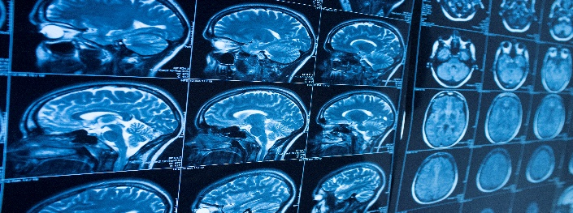
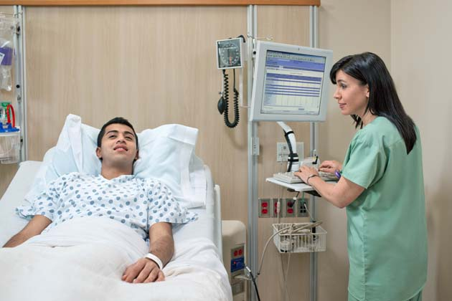

Q1: Clarify the extent to which you have taken into account the unmet medical
needs and requirements of clinicians of the Widening Country (3 of 3)
Sano has an effective mix of healthcare expertise throughout the value chain
Research to Clinical Deployment, across 7 major clinical domains
Health Science:
Research projects
SMEs and Start-ups:
Innovations
MedTech & Pharma:
Access to market
Healthcare:
Access to patients
9
Research proposals
Therapeutic areas
Universities
SMEs: Digital Health in Poland
Industrial corporations
11
11
Regional Hospitals including the most prestigious in Poland, STH in UK
7
EU-Industry
Partnership
EFPIA - IMI
3
Health clusters from the EU
3
6
1
Business Development
& Regulatory
3
Technology Park
1
Public body (Regional Medical Info System)
1
Venture Capital
1
Industrial Alliance (Avicenna)

Slide 5
Q2: Clarify and justify the balance of administrative staff to research staff (1 of 2)
Clarification: Staff balance, mix of high value jobs: R&D, programming, complex support, & IT
Research 58%*
Development 22%
Support 10%
Administration 10%
Scientific Affairs Director
Research Team Leaders
Visiting Professors
Postdocs
PhD Students
Business Development
Scientific Programming
Portfolio Manager
Marketing/Fundraising
Communications
Project Management
Project/Portfolio Manager
IT Experts (software/hardware)
Technical Manager
Data Manager
Secretariat
Financial services (accounting, payroll)
Human Resources
Legal Office
Overlapping roles, e.g. Scientific Programming Manager:
25% research 55% development
10% support 10% administration
* Includes stipends

Slide 6
Q2: Clarify and justify the balance of administrative staff to research staff (2 of 2)
Justification: Product development of clinical DSS at Sano requires diverse skill-sets
Opportunity
Clinical DSS creation process
Outcome
Disease or condition with strong societal impact
+
In silico technology
Iterative development, validation and pilot deployment of clinical solutions and tools
Marketable product
+
Exploitation strategy
Staff proportion:
Research
Research
Research
Development
Development
Development
Support
Support
Support
Administration
Administration
Administration
Advanced Partners provide: training; knowledge transfer across scientific, business and marketing disciplines
Differentiated funding sources: EU → development and support; national → mostly research
Aligned with typical research institutes: Fraunhofer, 2017 - scientific 54.5%, technical & administrative 45.5%

Slide 7
Q3: Clarify why the Director will be hired for a fixed 4-year term
Key Issue: 4 years is not a limit → It provides an opportunity for evaluation and reflection, for both parties
The strategy reflects best practice (Association of Governing Bodies of Universities and Colleges)
Report: ‘The most common length for a single term [board member of an independent research institution] is four years’*
It supports growth of strong candidates and ensures sustained excellence of leadership
The 4-year term also aligns with the requirements of the complementary IRAP grant
Formal bodies established (incl. Search Committee)
IRAP project completes; outcomes evaluated
Director’s initial term expires
Initial performance and portfolio review completed
ISC selects Director candidate
Centre formally joins the project
Self-sustainability
Formative phase
Maturity
Launch
M6
M12
M18
M24
M30
M36
M42
M48
M54
M60
M66
M72
Research leaders recruited
Statutory evaluation by Ministry of Science
Research agenda approved
Centre acquires legal status
Hiring commences
Clinical and industrial engagement assessed → annual report of the Centre
* https://www.agb.org/briefs/term-limit

Slide 8

Summary
The Reviewers’ questions have allowed us to highlight Sano’s clinical, scientific and human elements…
Unmet Clinical Need
Staff Balance
The Director
In silico medicine will come to dominate clinical practice, benefitting Polish clinics and Polish patients
The route to clinic is lengthy, and the Centre’s credibility is built on its experienced Partners’ full understanding of each step
Flexible contracting will allow selection of the optimal candidate at each step of the Centre’s progress
Benefit to Polish citizens
Full pathway support
Optimised leadership
Sano design has benefitted from the experience of a founder of Europe’s in silico initiative
The Widening Country is renowned for its entrepreneurial capability and drive, into the clinic
The Centre will capitalise on the synergy of the Advanced Partners to optimise each skill area
Poland will see a powerful mix of benefits, across academia, industry and clinical practice
Europe will enhance its leading position as both creators and exploiters of in silico medicine

